Slide 1
CRC Card

Slide 2
Intro
CRC Card = Class Responsibility Collaborator Card
Invented in 1989 by Kent Back and Ward Cunningham
A tool and method for systems analysis and design
Part of the OO development paradigm
Highly interactive
Results in the definition of objects and classes

Slide 3
What’s a CRC Card?
CRC stands for Class, Responsibility, and Collaboration.
Class
A set of objects that share common structure and common behaviour
Super-class: a class from which another class inherits
Subclass: a class that inherits from one or more classes
Responsibility
Some behaviour for which an object is held responsible.
Collaboration
process whereby several objects cooperate to provide some higher-level behaviour

Slide 4
Contd…
Help explore objects
Provide an ‘easy’ introduction
Starting point of many methodologies
Used in industry
Widely used in teaching

Slide 5
Contd…
A CRC card contains the following information:
A CRC card is an index card that is used to represent the responsibilities of classes and the interaction between the classes.
CRC cards are an informal approach to object oriented modeling.
The cards are created from use-case scenarios, based on the system requirements

Slide 6
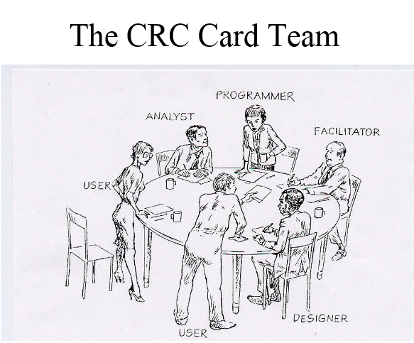
The CRC card Session
Groups consisting of five or six people.
Each group typically consists of developers, domain experts and an OO technology facilitator.

Slide 7
Format of CRC CARDS
Class name:
SuperClasses:
SubClasses
Responsibility
Collaborator

Slide 8
A CRC Card
Recording a Responsibility: List the responsibilities as concisely as possible.
An appropriate phrase (eg: know, maintain, compute, calculate, display, prompt, read, provide etc) correctly used conveys the meaning of the responsibility.
A class should not have a large number of responsibilities.

Slide 9
A CRC Card
Recording a Responsibility:
If the responsibilities cannot be fitted into one card, it is time to re-think the design.
May be you have included too much detail (may be you an find a phrase that briefly conveys the meaning of the responsibility)
May be the class is doing too many things (time to break up the class into several classes)
May be some of the responsibilities are already listed for the super class.

Slide 10
A CRC Card
Recording a Collaborator:
A class may have all the data (as data members) needed to fulfill a responsibility.
Or, a class has some data and knows other classes that have the rest to fulfill a responsibility. The other classes are identified as collaborators.
From a class’ perspective, the philosophy is “What I know” and “Who I know” to fulfill a responsibility.

Slide 11
CRC Cards
Step 1: Identify the classes in the problem domain.
Use the problem statement or requirements document to find all of the nouns and verbs in the problem statement.
The nouns represent the object/classes in the system; the verbs may show what their responsibilities are.

Slide 12
CRC Cards
Step 2: Take at least one card per person. Each person should be responsible for at least one class.
Step 3: Add the class name and add responsibilities that are obvious from the requirements. Attributes typically are not added at this time. Add super or subclasses that are obvious.

Slide 13
CRC Cards
Step 4: Walk-through a scenario that represents an important system function in the requirements document.
Decide which class (es) is responsible for this function. The owner of the class then picks up her card and announces that she needs to fulfill this responsibility.
The responsibility may be refined into smaller tasks if possible.
These smaller tasks can be fulfilled by the same object or they can be fulfilled be interacting with other objects.
If no appropriate class (to fulfill this responsibility) exists, you may need to make a class.

Slide 14
Example-Vending Machine
Specification :
A Vending machine holds a number of snack items and displays the list of snack items and their prices through an user interface with a display screen and buttons for making selections. In addition, the vending machine has a receptacle for money and an item dispenser.
A user can make a selection and query for the number of calories of a snack item. The calories are displayed on pressing a button. A user can place the money in the receptacle and select an item.

Slide 15
Example-Vending Machine
Step 1: Let us select the nouns and the verbs in the specification.
Nouns are in blue and the verbs are in red.
A Vending machine holds a number of snack items and displays the list of snack items and their prices through an user interface with a display screen and buttons for making selections. In addition, the vending machine has a receptacle for money and an item dispenser.
A user can make a selection and query for the number of calories of a snack item. The calories are displayed on pressing a button. A user can place the money in the receptacle and select an item.

Slide 16
Example-Vending Machine
Most of the nouns are objects/classes.
Some nouns are attributes of these classes.
The verbs are actions that can be attached to these objects.
In order to focus on the problem-domain objects, let us separate the object/classes into presentation-specific (user-interface related) and problem-specific classes.
We will then select two problem specific classes and write the CRC cards for them.

Slide 17
Example-Vending Machine
Problem-specific classes:
Vending Machine
Snack item
Price
Calories
Selection
User
Presentation-specific classes:
Display screen
Selection Buttons
Item Dispenser
Money receptacle

Slide 18
A CRC card for class SnackItem
Class name: SnackItem
Responsibility
Collaborator
Knows its price and calories

Slide 19
A CRC card for the Vending Machine
Class name: VendingMachine
Responsibility
Collaborator
Maintains a collection of SnackItems.
Allows addition and removal of SnackItems
SnackItem

Slide 20

Showing the Collaboration of a VendingMachine and SnackItem

Slide 21
CRC cards
References on CRC cards:
A Laboratory For Teaching Object-Oriented Thinking Kent Beck, Apple Computer,Inc http://c2.com/doc/oopsla89/paper.html
Introduction to CRC cards by David Rubin http://www.softstar-inc.com/Methodology/CRCIntro.htm
Designing Object-Oriented Software by Rebecca Wirfs-Brock, Brian Wilkerson and Lauren Wiener,

